Slide 1

Data Cleaning
Dr. Arun Ayyar

Slide 2
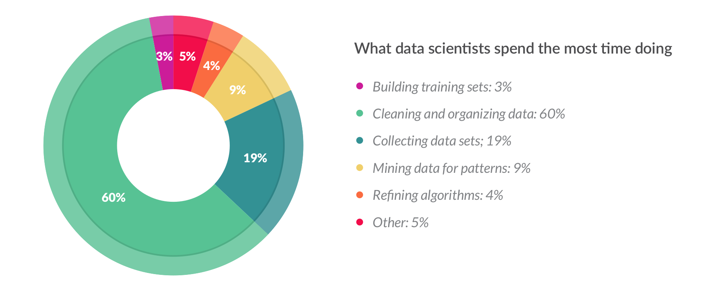

CrowdFlower Report :https://www2.cs.uh.edu/~ceick/UDM/CFDS16.pdf

Slide 3
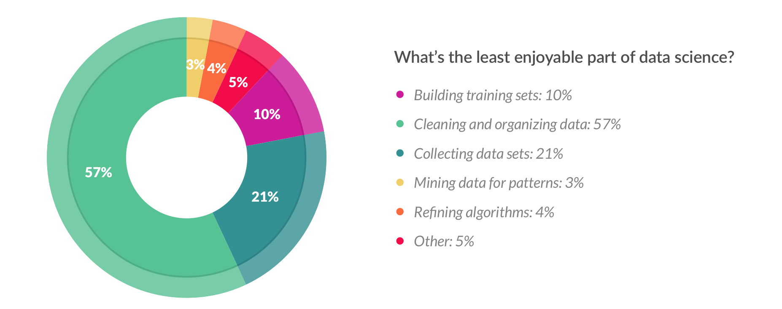

CrowdFlower Report :https://www2.cs.uh.edu/~ceick/UDM/CFDS16.pdf

Slide 4

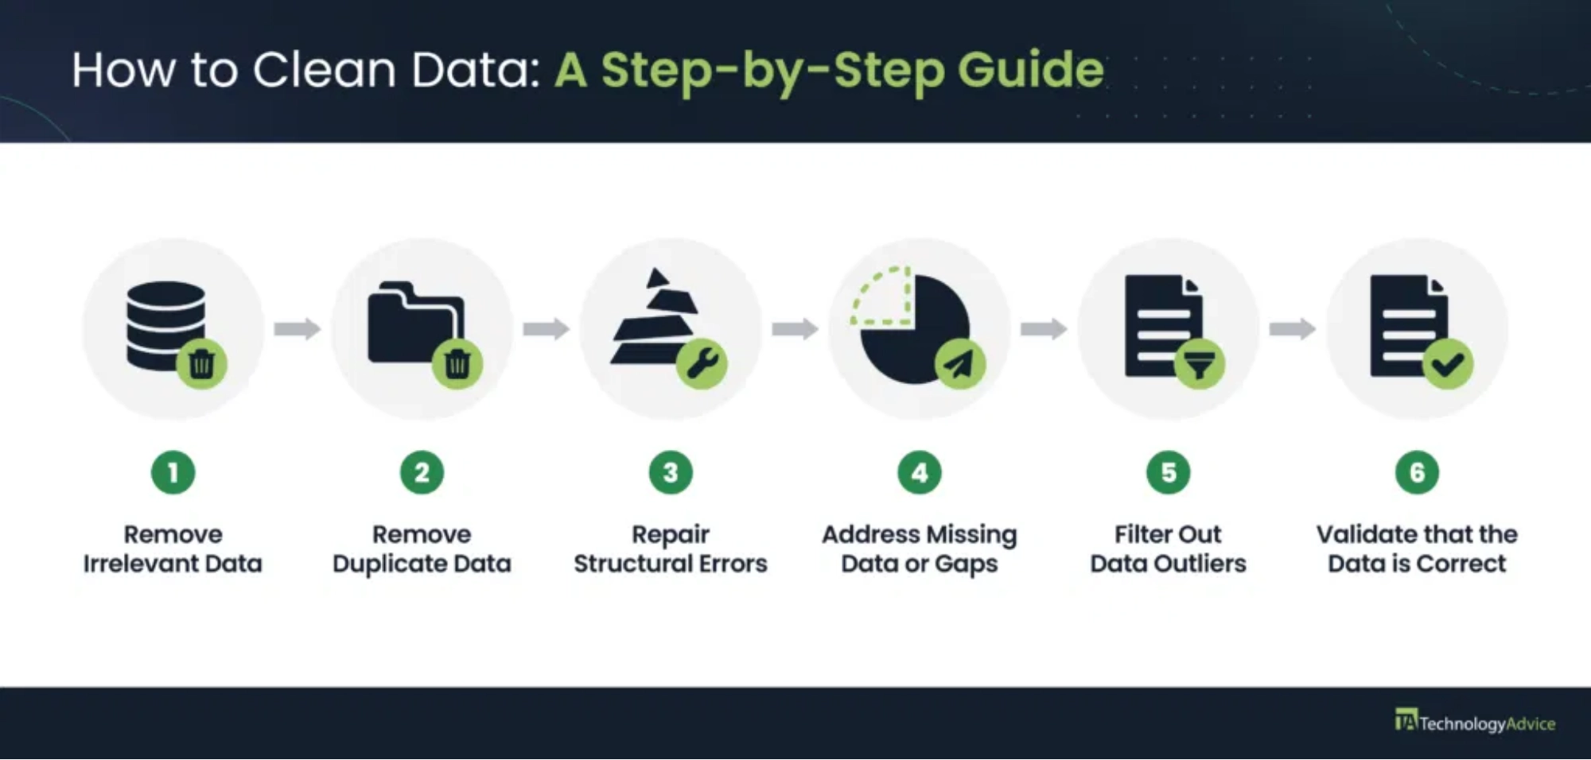

What is Data Cleaning?
Data cleaning
is the process of identifying and correcting
errors, inconsistencies, and inaccuracies in datasets to
improve data quality.
Ensures data accuracy and reliability
Critical first step in any data analysis
Improves decision-making quality
Reduces errors in machine learning models

Slide 5
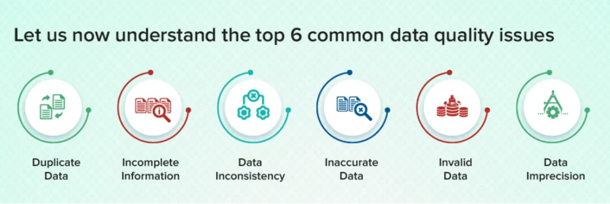





Common Data Quality Issues
Before cleaning data, it's essential to identify common quality issues that affect datasets:
Missing Values:
Empty fields or null values
Duplicate Records:
Identical or near-identical entries
Inconsistent Formatting:
Different formats for same
data type
Outliers:
Values that deviate significantly from the norm
Typos & Errors:
Misspellings and incorrect entries

Slide 6
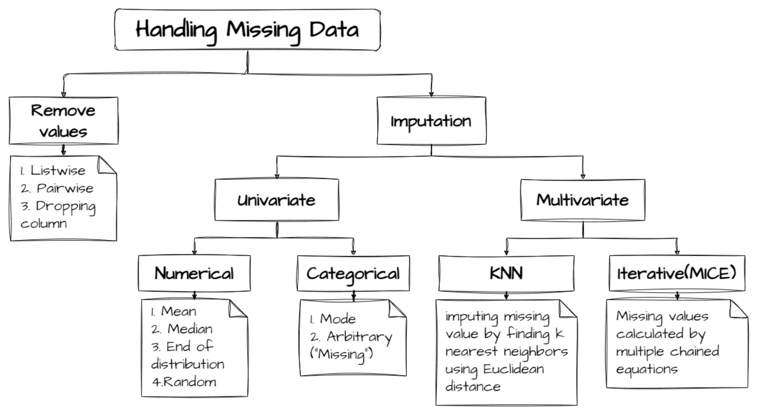





Data Cleaning Techniques
Effective data cleaning employs various techniques to address different quality issues:
Handling Missing Values:
Imputation, deletion, or
flagging
Removing Duplicates:
Identifying and eliminating
redundant records
Standardization:
Converting data to consistent formats
Error Correction:
Fixing typos and inconsistencies
Outlier Treatment:
Identifying and handling extreme
values

Slide 7
Missing Data Example
id | age | education_years | income | health_score | gender
1 | 22 | 12 | 25000 | 78 | Male
2 | 45 | 16 |  | 88 | Female
3 | 19 | 15 | 18000 |  | Male
4 | 34 | 14 | 35000 | 92 | Female
5 | 28 | 10 |  | 60 | Male

Slide 8

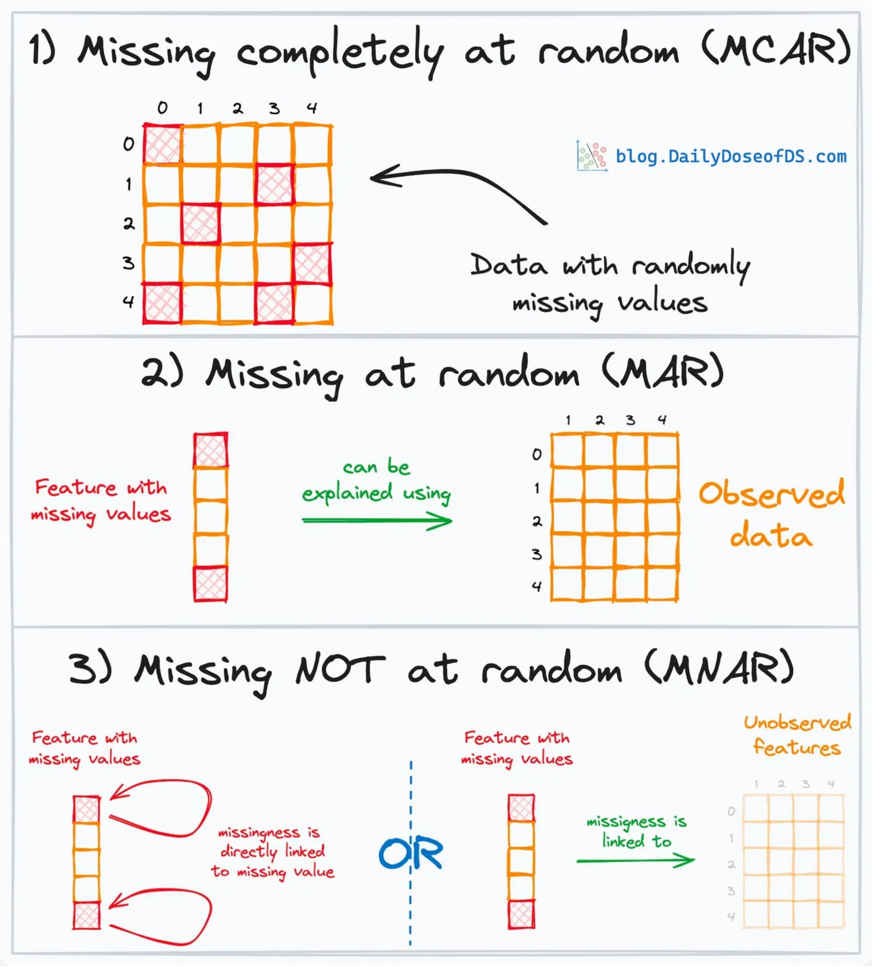
Types of Missing Values
MCAR - Missing Completely at Random
Missing values occur randomly and are unrelated to any observed or unobserved variables.
Example: Equipment malfunction causing random data loss
MAR - Missing at Random
Missing values are related to observed variables but not to the missing values themselves.
Example: Younger people less likely to report income
MNAR - Missing Not at Random
Missing values are related to the unobserved values themselves.
2 / 25
Example: High earners refusing to disclose salary

Slide 9

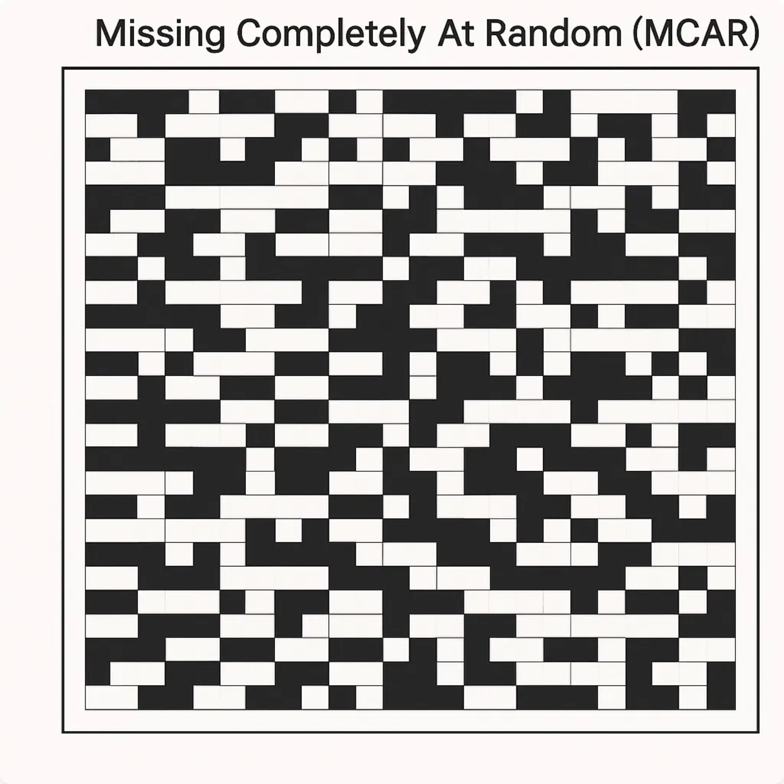
Missing Completely at Random (MCAR)
Characteristics
Missing values occur randomly across all observations
No relationship between missingness and any variable
Missing data pattern is unpredictable
Easiest type to handle statistically
Key Point:
MCAR is the ideal scenario for missing data
analysis as it doesn't introduce bias into the dataset.
Examples
Equipment malfunction during data collection
Random survey non-response due to technical issues
Data entry errors occurring randomly
3 / 25

Slide 10

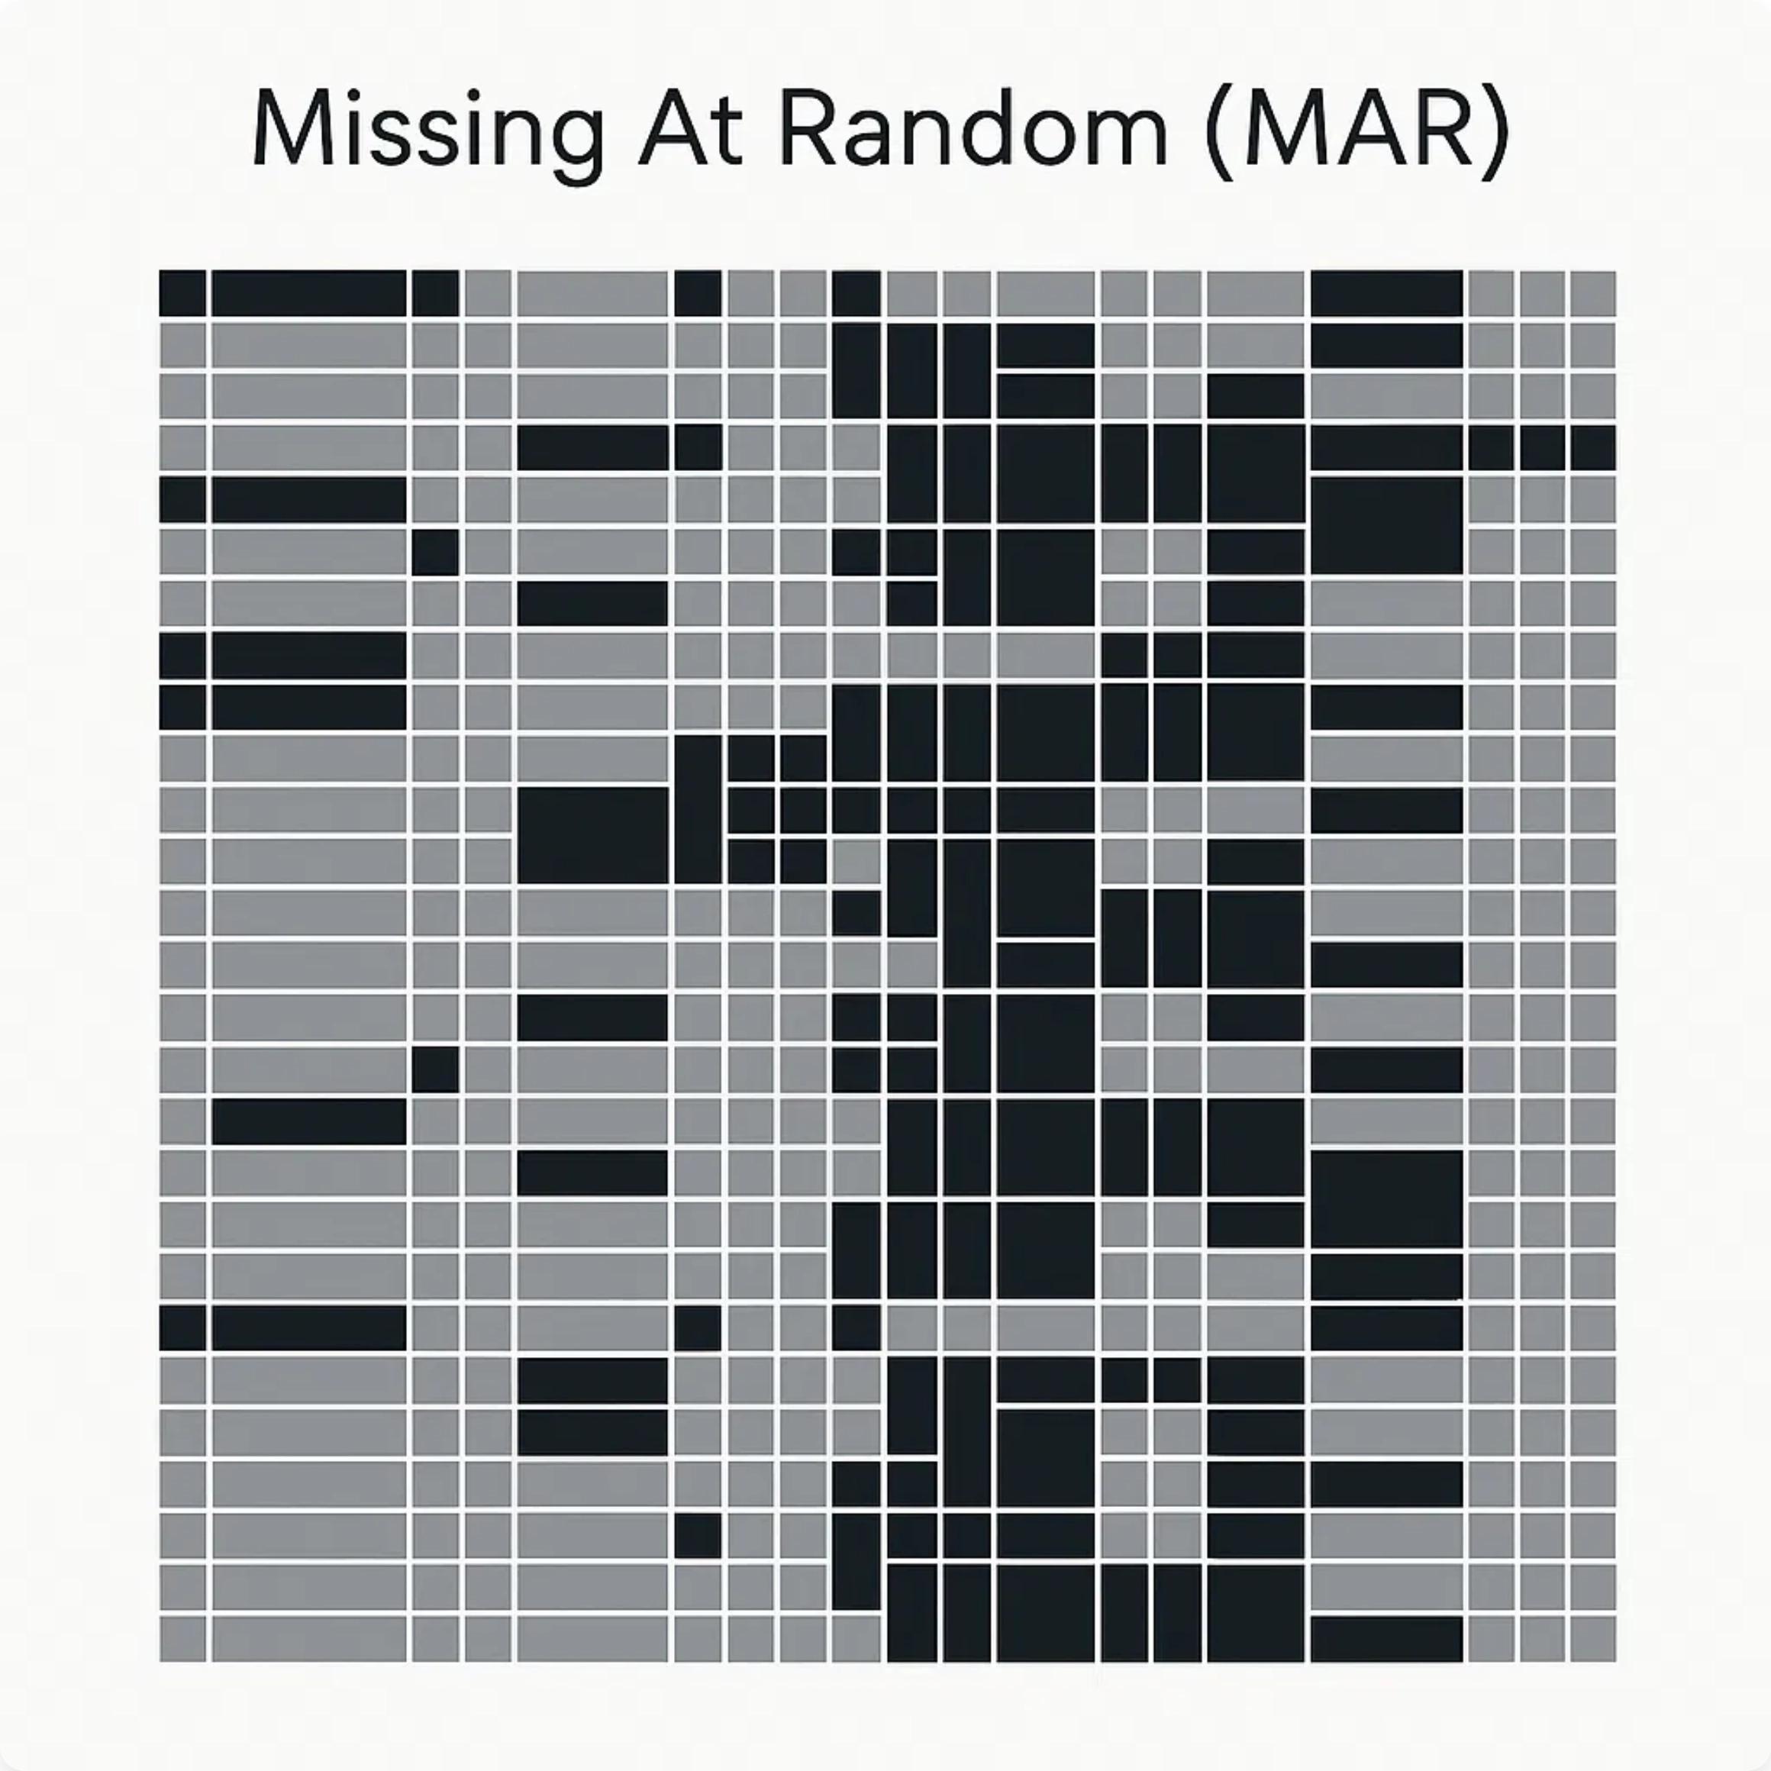
Missing at Random (MAR)
Characteristics
Missing values are related to observed variables
Missingness can be predicted from other variables
Not random, but systematic in relation to known data
More common in real-world datasets than MCAR
Key Point:
MAR allows for valid statistical inference if the
variables related to missingness are included in the
analysis.
Examples
Younger respondents less likely to report income
Men less likely to answer health-related questions
4 / 25
Rural areas with more missing environmental data

Slide 11

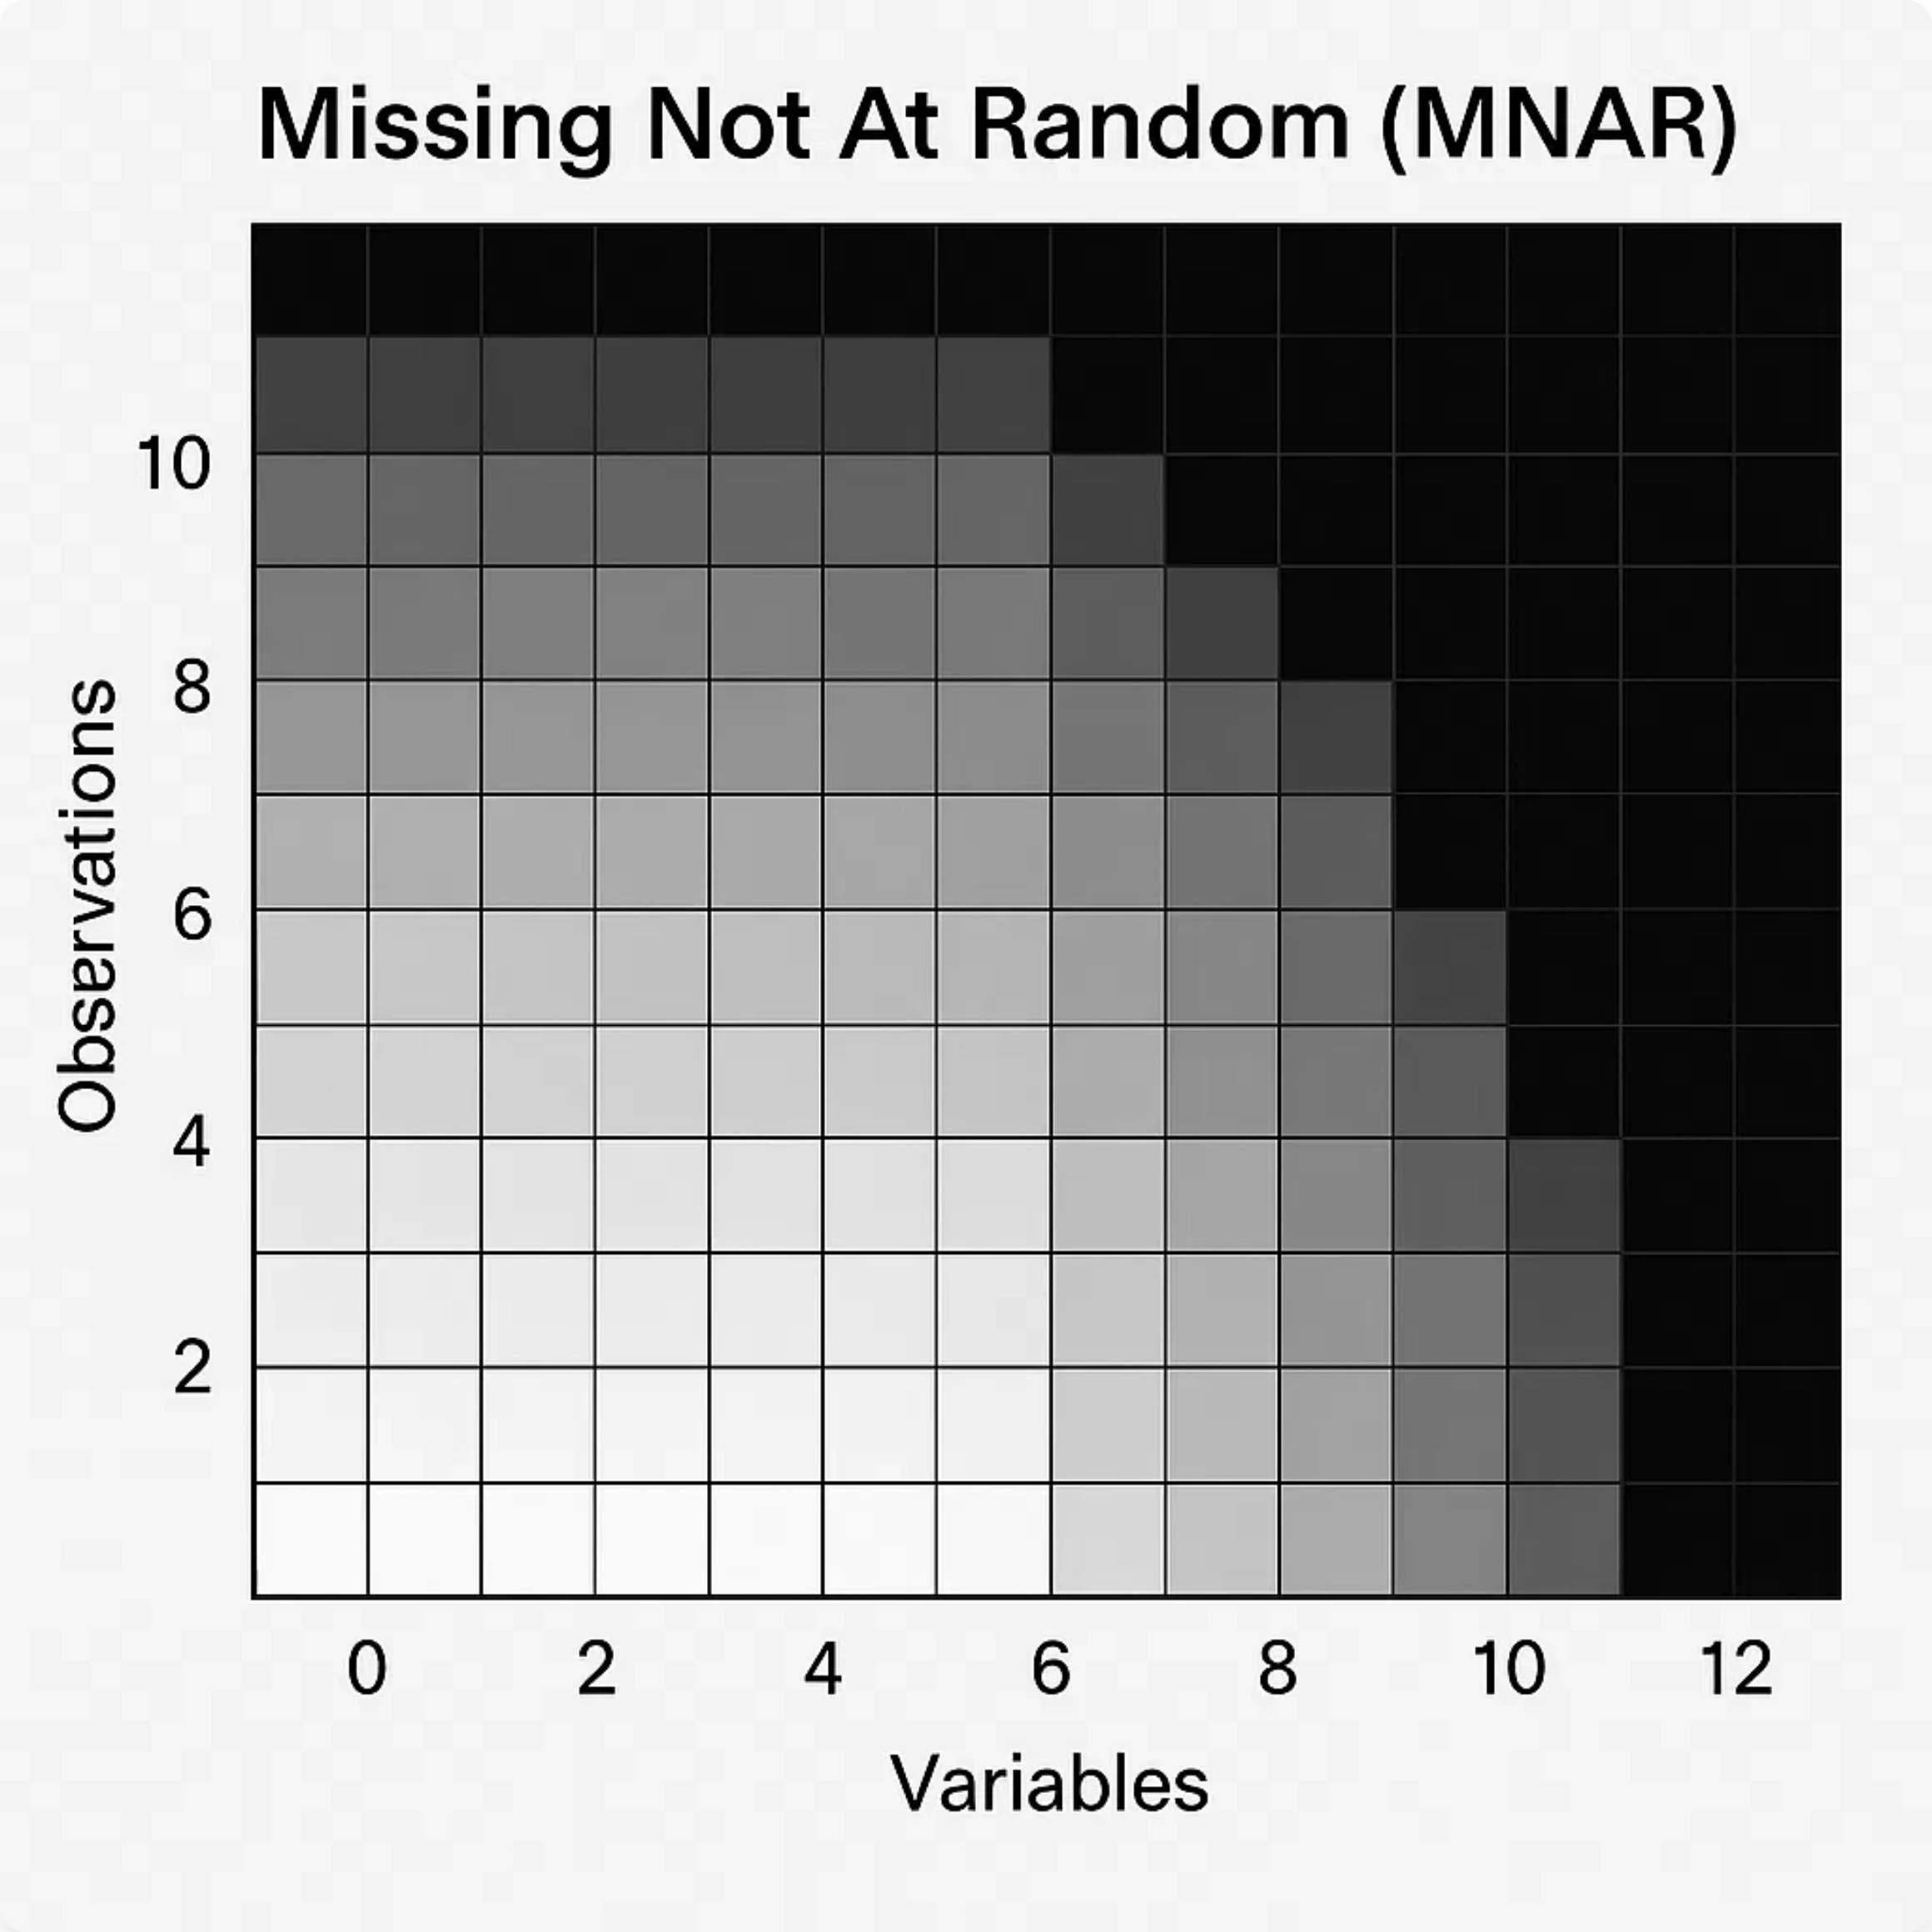
Missing Not at Random (MNAR)
Characteristics
Missing values are related to the unobserved values themselves
Missingness depends on information that is not observed
Creates systematic bias in the dataset
Most challenging type to handle statistically
Key Point:
MNAR requires careful consideration of the
missing data mechanism and often needs domain
knowledge to address properly.
Examples
People with high income refusing to disclose their salary
Patients dropping out of a study due to severe side effects
5 / 25
Sensors failing to record extremely high or low values

Slide 12
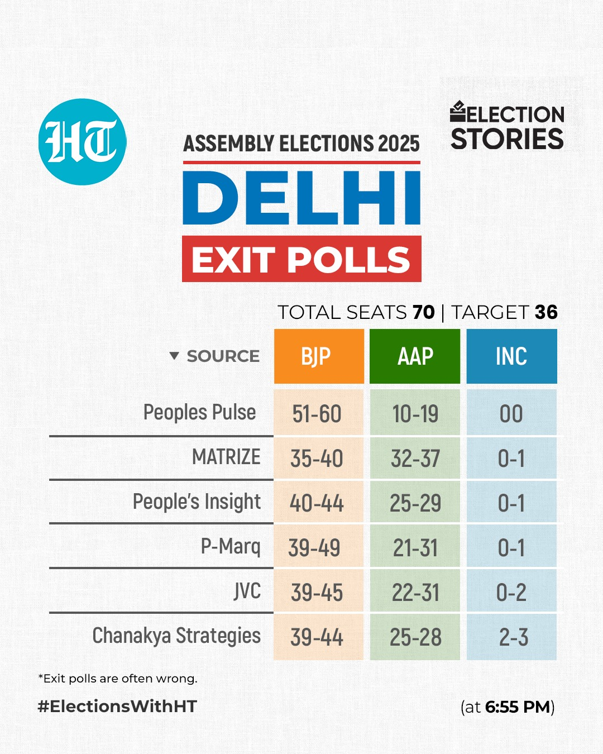
Example to Explain missing data – Exit Polls
Imagine you are collecting exit poll data right after an election.
You stand outside polling booths and ask voters:
Whom they voted for
Their age, gender, income, etc.
But some people don’t answer some questions, creating missing data.
The key question is: why are values missing?
That determines whether data is MCAR, MAR, or MNAR.

Slide 13
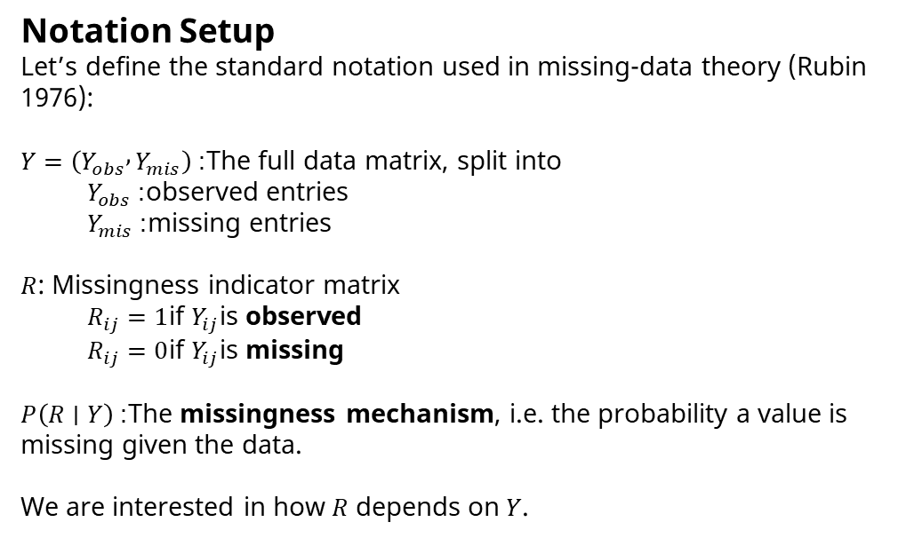
Example to Explain missing data – Exit Polls
Notation Setup
Let’s define the standard notation used in missing-data theory (Rubin 1976):
$Y=\left(Y_{obs} , Y_{mis}\right)$: The full data matrix, split into
$Y_{obs}$: observed entries
$Y_{mis}$: missing entries
$R$: Missingness indicator matrix
$R_{ij}=1$if $Y_{ij}$is observed
$R_{ij}=0$if $Y_{ij}$is missing
$P\left(R∣Y\right)$: The missingness mechanism, i.e. the probability a value is missing given the data.
We are interested in how $R$ depends on $Y$.

Slide 14
Example to Explain missing data – Exit Polls
MCAR — Missing Completely At Random
Definition: The probability that a value is missing is independent of both observed and unobserved data.
Exit Poll Example :
Some voters leave quickly because they’re late to work.This has nothing to do with who they voted for or any of their characteristics.
5% of forms are lost in the wind — purely by chance. Whether the missing response belonged to Party A or Party B supporters doesn’t matter.
Implication:
Missingness introduces no bias; data is just smaller.

Slide 15
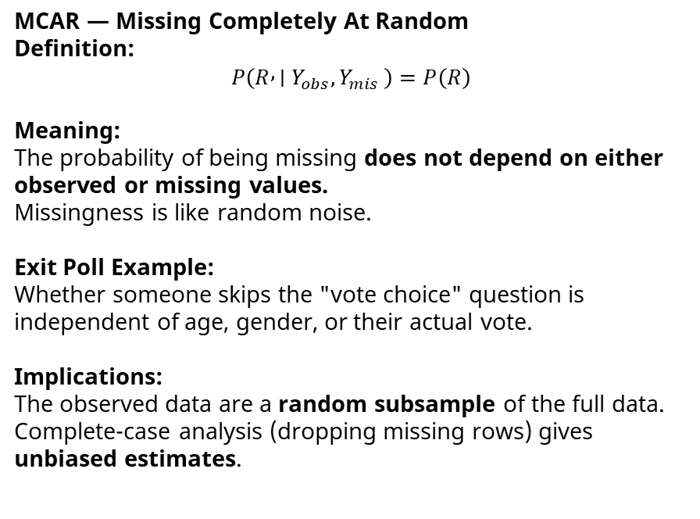
Example to Explain missing data – Exit Polls
MCAR — Missing Completely At Random
Definition:
$$P\left(R , ∣Y_{obs}{,Y}_{mis}\right)=P\left(R\right)$$
Meaning:
The probability of being missing does not depend on either observed or missing values.
Missingness is like random noise.
Exit Poll Example:
Whether someone skips the "vote choice" question is independent of age, gender, or their actual vote.
Implications:
The observed data are a random subsample of the full data.
Complete-case analysis (dropping missing rows) gives unbiased estimates.

Slide 16
Example to Explain missing data – Exit Polls
MAR — Missing At Random
Definition: Missingness depends on observed data, but not on the missing value itself.
Exit Poll Example:
Younger voters are more likely to refuse answering who they voted for. But among people of the same age, refusal doesn’t depend on their actual vote.
Suppose 30% of people under 25 skip the “vote choice” question, and only 5% of older voters do — but within each age group, missingness is unrelated to the vote.
Implication:
You can statistically adjust for missingness by using the observed variables (like age).
Methods: multiple imputation, regression-based imputation.
missingness is predictable from other known info.

Slide 17
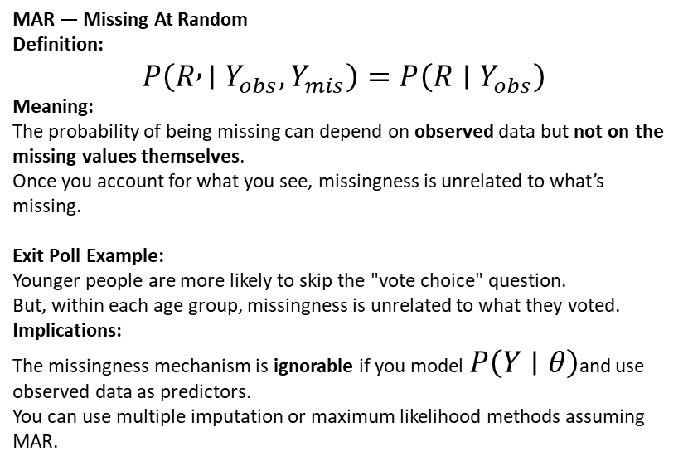
Example to Explain missing data – Exit Polls
MAR — Missing At Random
Definition:
$$P\left(R , ∣Y_{obs},Y_{mis}\right)=P\left(R∣Y_{obs}\right)$$
Meaning:
The probability of being missing can depend on observed data but not on the missing values themselves.
Once you account for what you see, missingness is unrelated to what’s missing.
Exit Poll Example:
Younger people are more likely to skip the "vote choice" question.
But, within each age group, missingness is unrelated to what they voted.
Implications:
The missingness mechanism is ignorable if you model $P\left(Y∣θ\right)$and use observed data as predictors.
You can use multiple imputation or maximum likelihood methods assuming MAR.

Slide 18
Example to Explain missing data – Exit Polls
MNAR — Missing Not At Random
Definition: Missingness depends on the unobserved value itself — i.e. what’s missing affects its chance of being missing.
Exit Poll Example:
People who voted for a controversial or unpopular party are more likely to refuse to answer. This refusal is directly linked to their actual (missing) vote.
50% of Party X voters refuse to answer, but 5% of others do. Even if you know their age, gender, etc., you can’t explain this missingness without knowing the vote itself.
Implication:
Creates systematic bias.
Hard to fix unless you make explicit model assumptions or get external data.
people hide info because of the info itself.

Slide 19
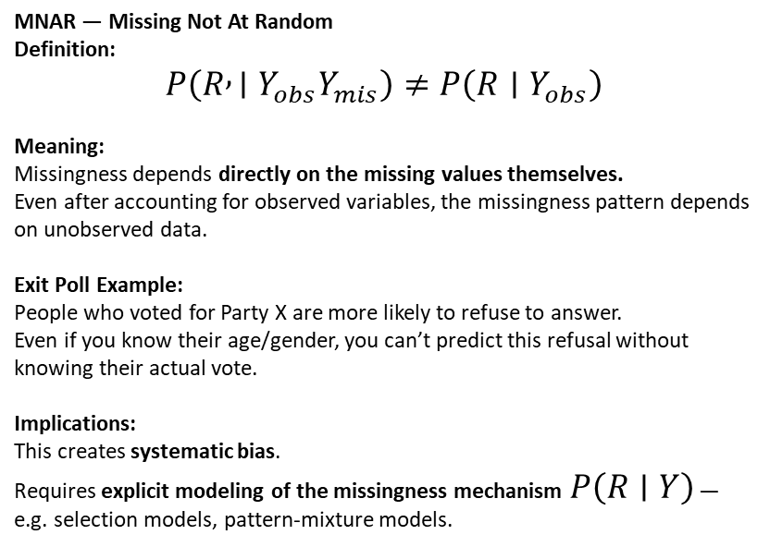
Example to Explain missing data – Exit Polls
MNAR — Missing Not At Random
Definition:
$$P\left(R , ∣Y_{obs}Y_{mis}\right)≠P\left(R∣Y_{obs}\right)$$
Meaning:
Missingness depends directly on the missing values themselves.
Even after accounting for observed variables, the missingness pattern depends on unobserved data.
Exit Poll Example:
People who voted for Party X are more likely to refuse to answer.
Even if you know their age/gender, you can’t predict this refusal without knowing their actual vote.
Implications:
This creates systematic bias.
Requires explicit modeling of the missingness mechanism $P\left(R∣Y\right)$— e.g. selection models, pattern-mixture models.

Slide 20
Real Life example – 2016 exit polls
Lower response rates from Trump-leaning groups
Response rates were lower among rural, non-college-educated white voters — a group that heavily supported Trump.
This created MNAR-type missingness:
The likelihood of not responding was directly related to the unobserved variable (their vote choice).
Pollsters tried to reweight responses by age, gender, race, etc. assuming MAR (missing at random).
But because the missingness was actually MNAR, the model could not infer the hidden Trump voters from observed demographics.
As a result, exit polls overrepresented college-educated voters (who leaned Clinton) and underrepresented non-college whites (who leaned Trump).
https://www.nytimes.com/interactive/2016/11/08/us/politics/election-exit-polls.html

Slide 21
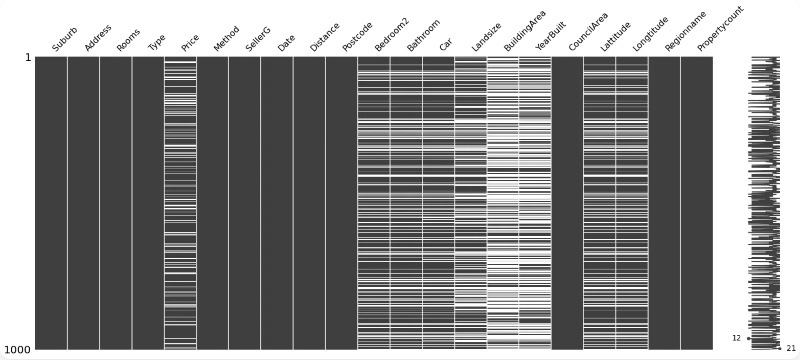
Visual Patterns of Missing Data
Why Visualize Missing Data?
Quickly identify patterns and relationships in missingness
Detect potential bias in the dataset
Guide selection of appropriate imputation methods
Validate assumptions about missing data mechanisms
Key Visualization Techniques:
Matrix plots (missingness maps)
Correlation heatmaps
Dendrogram clustering
Upset plots for pattern intersections
6 / 25

Slide 22
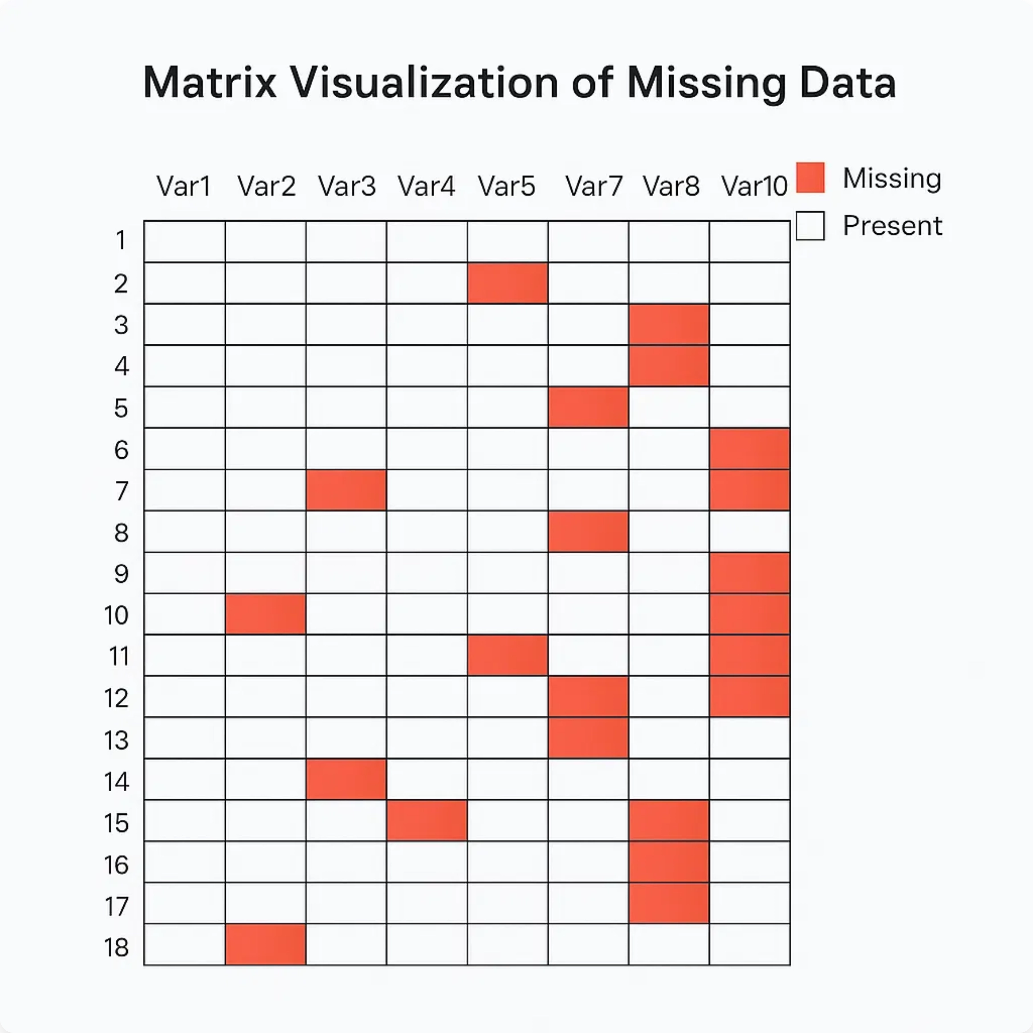
Matrix Visualization
What is Matrix Visualization?
Visual representation of missing data patterns across variables and observations
Rows represent observations, columns represent variables
Missing values are highlighted in a distinct color
Helps identify patterns and relationships in missingness
Implementation
# Python with missingno library
import missingno as msno
msno.matrix(dataframe)
Useful for identifying systematic patterns in missing data
Can reveal relationships between variables' missingness
7 / 25

Slide 23

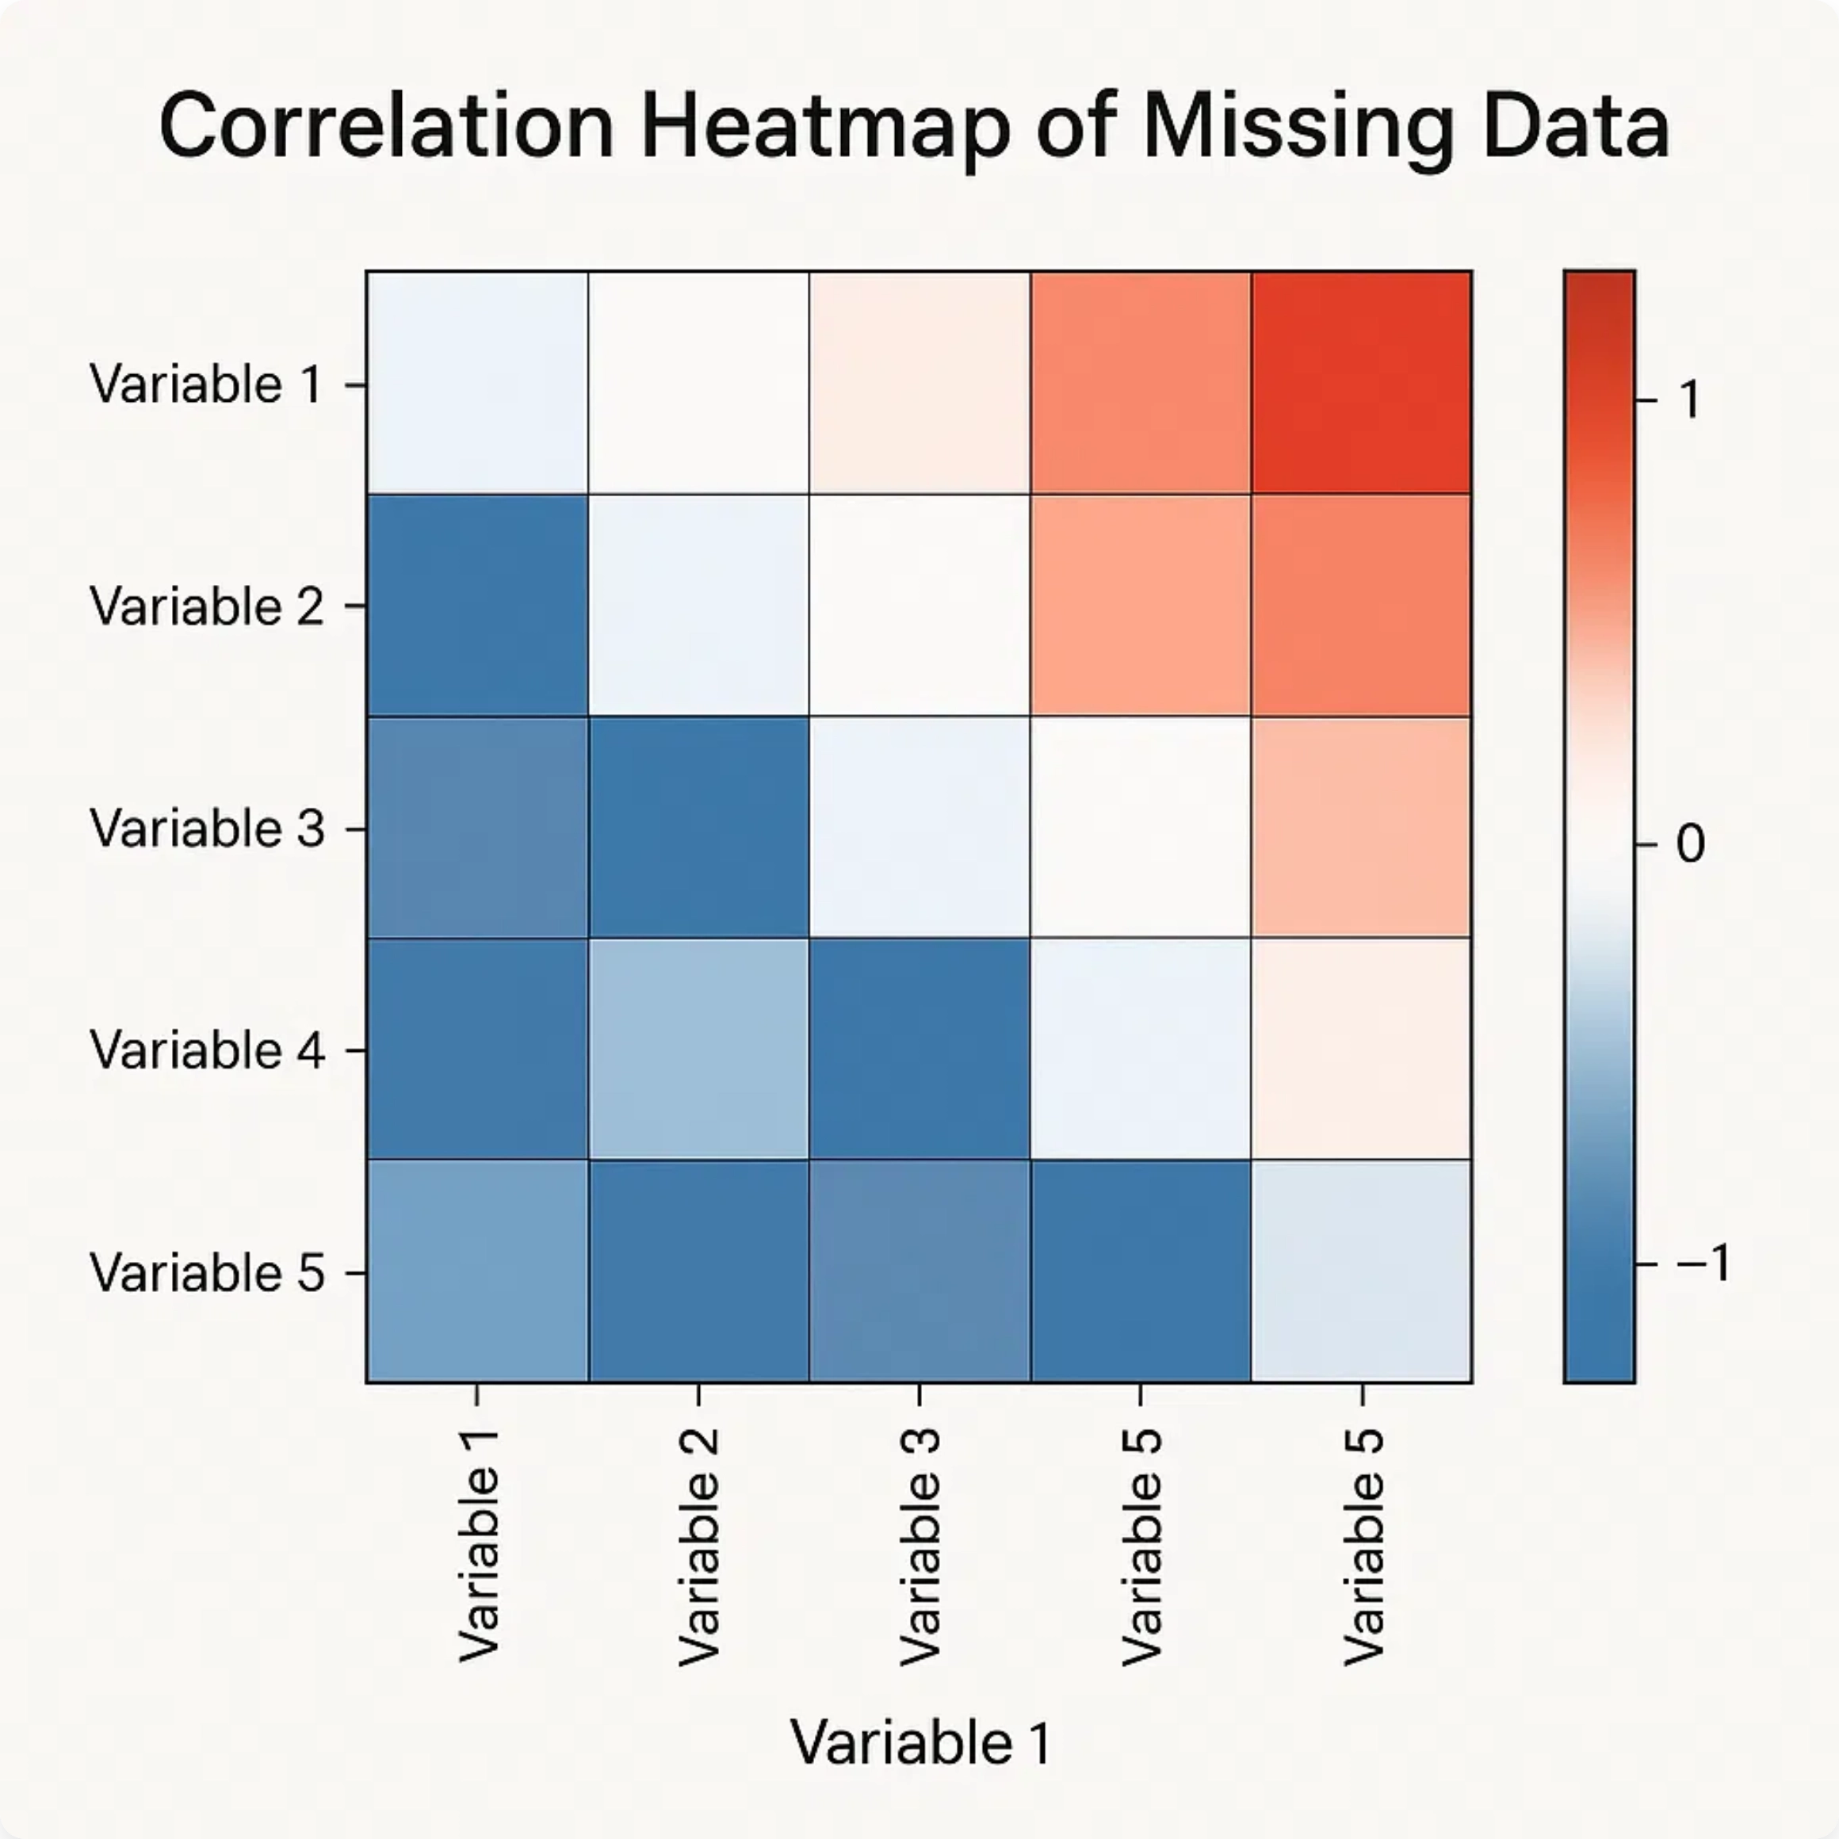
Correlation Heatmaps
Using Correlation Heatmaps
Visualizes pairwise correlations between missingness in variables
Helps identify relationships between missing data patterns
Strong correlations suggest systematic missingness (MAR or MNAR)
No correlations suggest random missingness (MCAR)
Interpretation:
Strong correlation between missing
values in two variables indicates that when one variable
is missing, the other is likely to be missing as well.
Implementation
Create binary indicators for missingness (1=missing, 0=present)
8 / 25
Calculate correlation matrix between these indicators
Visualize using a heatmap with color gradient

Slide 24

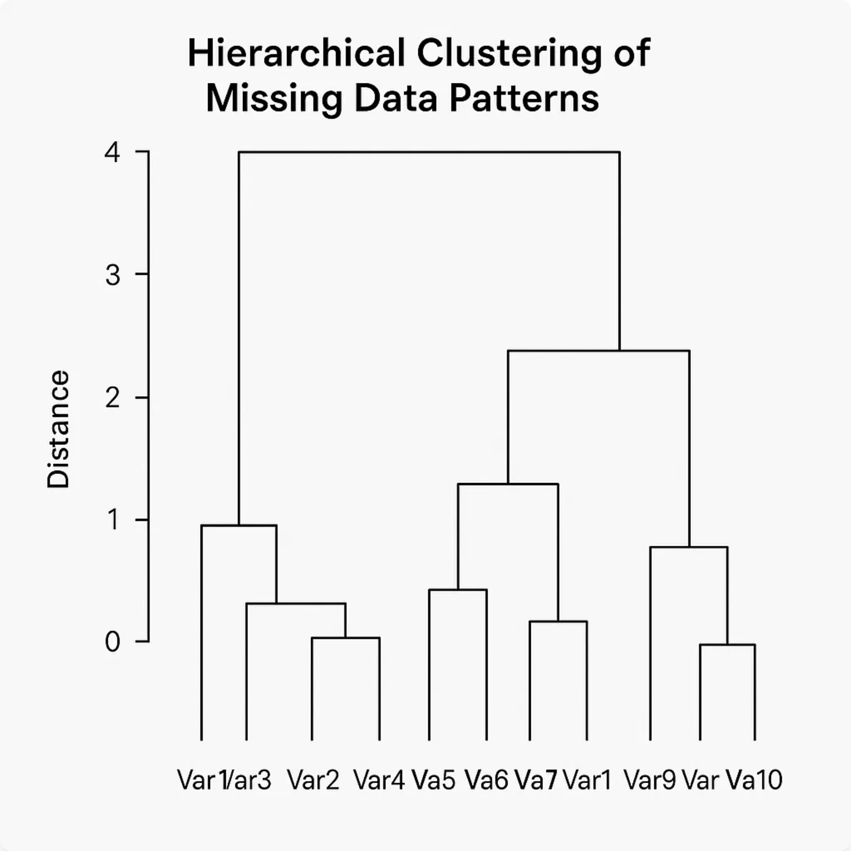
Dendrogram Clustering
Hierarchical Clustering for Missing Data
Uses agglomerative hierarchical clustering to group variables
Groups variables with similar missing data patterns
Helps identify clusters of variables that tend to be missing together
Particularly useful for high-dimensional datasets
Benefits:
Provides a visual way to identify groups of
variables with similar missingness patterns without
examining numerous pairwise correlations.
Implementation
# Python with missingno library
9 / 25
import missingno as msno
msno.dendrogram(dataframe)

